Slide 1
Test Management
Lecture 13
Madiha Malik

Slide 2
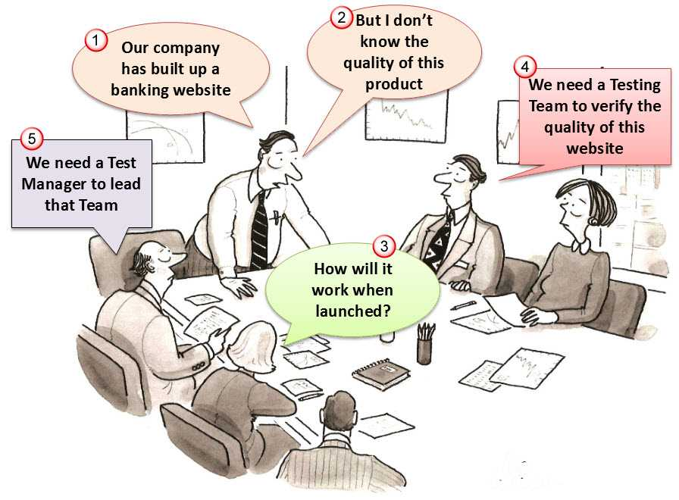
Your company, a financial corporation, built up a banking website. This is the biggest software project ever in your company & your boss wants the highest quality product
Notes:
The development team worked so hard to make the website. Now this website is setup at server. http://demo.guru99.com/
However, they are not sure how effectively it will work when launched in real business environment.
Your boss assigned you as Test Manager of the project. Your task is to verify and evaluate the quality of website Bank before delivering it to the customer.

Slide 3
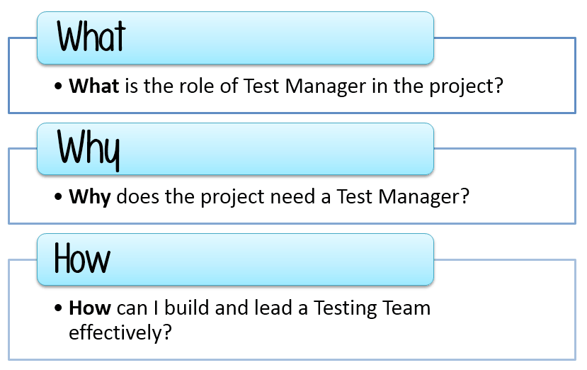
Test Manager Focuses on:

Slide 4
What is Test Management
An important part of software quality is the process of testing and validating the software.
Test Management is the practice of
  Organizing and controlling the Testing process.
  Ensuring visibility, traceability, and control of testing process to deliver high-quality software.

Slide 5
Role and Responsibility of Test Manager
Building up and leading the Testing Team to the success of project
Defining the scope of testing within the context of each release / delivery
Deploying and managing resources for testing
Applying the appropriate test measurements and metrics in the product and the Testing Team
Planning, deploying and managing the testing effort for any given engagement.

Slide 6
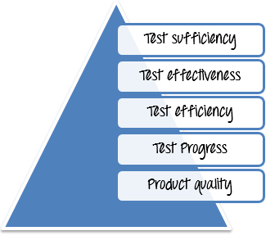
Challenges in Test Management
Not enough time to test
Not enough resources to test
The project budget is low, and schedule is too tight
Testing teams are not always in one place
The requirements are too complex to check and validate

Slide 7
Test Management Problem
Imagine now you are Test Manager of the project: verify and evaluate the quality of website ”http://demo.bankexample.com” before launching it to the customer.
Your boss wants to discuss with you about the project planning, the test sufficiency, budget, and progress. Are you ready? Let’s join in the discussion

Slide 8
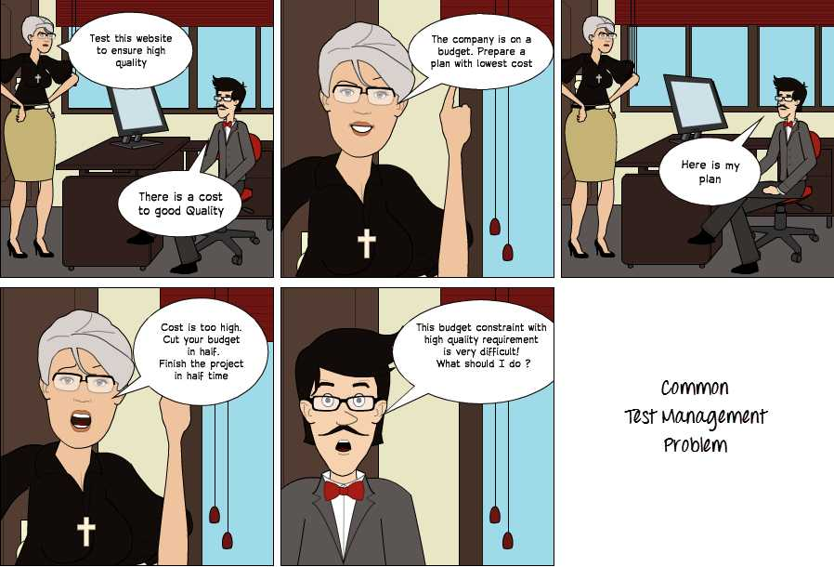
Notes:
The above example is just one of many difficulties you may face in your Task. The next tutorials will help you overcome these difficulties to your success.

Slide 9
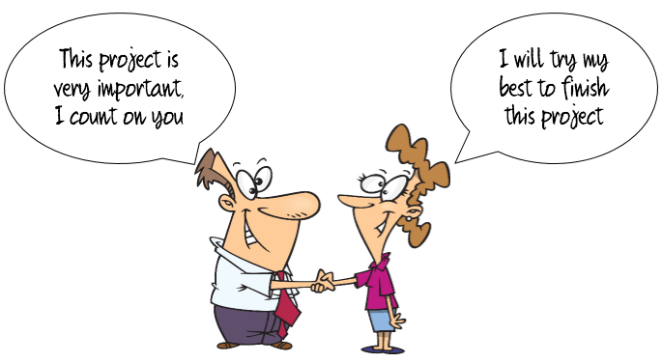
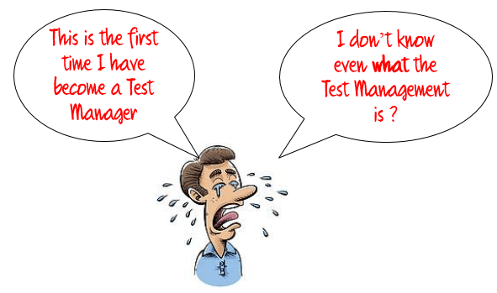
Test Management Process
Notes:
You become a Test Manager of the most important project in your company. The project task is to test the net banking facility of the esteemed “Demo Bank”

Slide 10
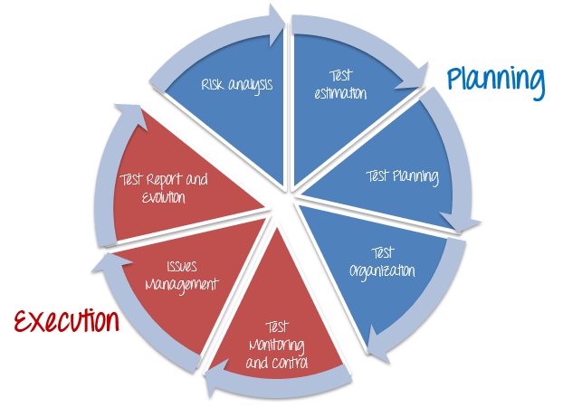
Test Management Phases

Slide 11
Test Management Process
There are two main Parts of Test Management Process: -
Planning
  Risk Analysis
  Test Estimation
  Test Planning
  Test Organization
Execution
  Test Monitoring and Control
  Issue Management
  Test Report and Evaluation

Slide 12
Planning - Risk Analysis and Testing
Risk is the potential loss (an undesirable outcome, however not necessarily so) resulting from a given action or an activity.
Risk Analysis is the first step which Test Manager should consider before starting any project. Because all projects may contain risks, early risk detection and identification of its solution will help Test Manager to avoid potential loss in the future & save on project cost.

Slide 13
Planning - Risk Analysis and Testing
Define risk level by using likelihood and impact
Distinguish between project and product risks
Describe, by using examples, how product risk analysis may influence the thoroughness and scope of testing

Slide 14
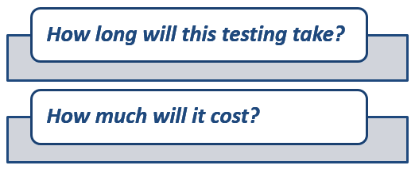
Planning - Test Estimation
Test Estimation is a management activity which approximates how long a Task would take to complete. Estimating effort for the test is one of the major and important tasks in Test Management.
Why Test Estimation?

Slide 15

What to Estimate?

Slide 16
What to Estimate?
Resources: Resources are required to carry out any project tasks.
  people, equipment, facilities, funding, or anything else capable of definition required for the completion of a project activity.
Times : Time is the most valuable resource in a project. Every project has a deadline to delivery.
Human Skills : Human skills mean the knowledge and the experience of the Team members.
  They affect to your estimation. For example, a team, whose members have low testing skills, will take more time to finish the project than the one which has high testing skills.
Cost: Cost is the project budget.
  how much money it takes to finish the project.

Slide 17
How to Estimate?
Work Breakdown Structure
3-Point Software Testing Estimation Technique
Wideband Delphi technique
Function Point/Testing Point Analysis
Use – Case Point Method
Percentage distribution
Ad-hoc method

Slide 18
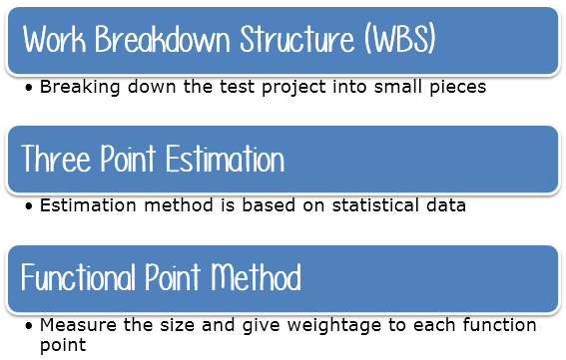
How to Estimate?

Slide 19
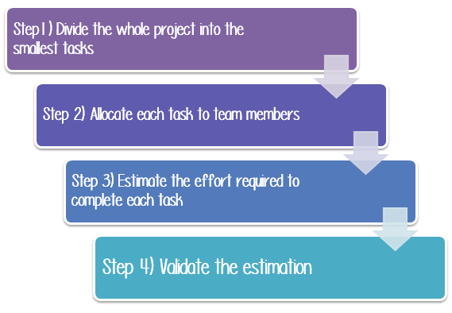
Steps to arrive at an Estimate

Slide 20
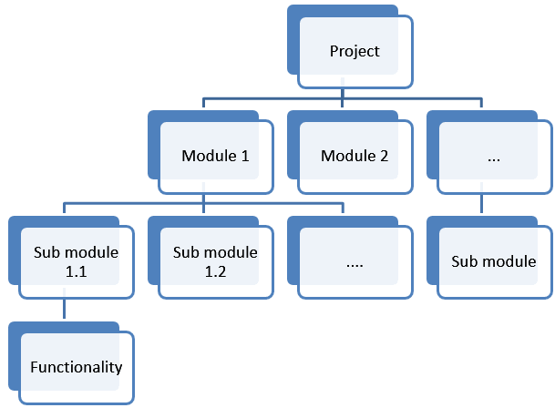
Step1) Divide the whole project task into subtasks

Slide 21
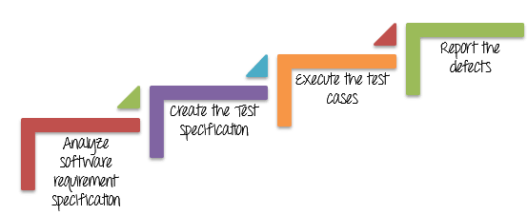
Work Break Down Structure
For example for banking project:

Slide 22
Task | Sub-Task
Analyze software requirement specification | Investigate the soft requirement specs Interview with the developer & other stakeholders to know more about the website
Create the Test Specification | Design test scenarios Create test cases Review and revise test cases
Execute the test cases | Build up the test environment Execute the test cases Review test execution results
Report the defects | Create the Defect reports Report the defects

Slide 23
Step 2) Allocate each task to team member
Task | Members
Analyze software requirement specification | All the members
Create the Test Specification | Tester/Test Analyst
Build up the test environment | Test Administrator
Execute the test cases | Tester, Test Administrator
Report the defects | Tester

Slide 24
Step 3) Effort Estimation For Tasks
  Functional Point Method
  Three Point Estimation

Slide 25

Function Point Method

Slide 26
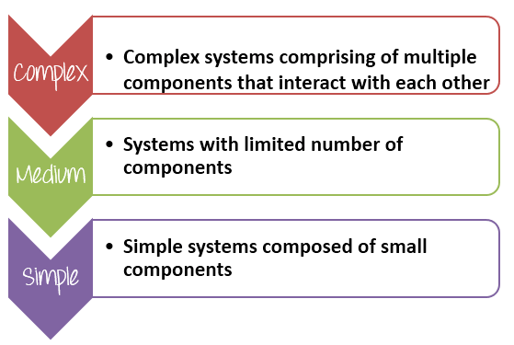
Function Point Method
Step A) Estimate size for the task
Notes:
See table

Slide 27
Function Point Method
Step A) Estimate size for the task
For Example, You Identify 12 Function Points for task “Create the test specification” and give them weightage according to its size.
Group | Weightage
Complex | 5
Medium | 3
Simple | 1
Notes:
See table

Slide 28

Function Point Method
STEP B) Estimate duration for the task
Total Effort: The effort to completely test all the functions of the website
Total Function Points: Total modules of the website
Estimate defined per Function Points: The average effort to complete one function points. This value depends on the productivity of the member who will take in charge this task.

Slide 29
Function Point Method Example
 | Weightage | # of Function Points | Total
Complex | 5 | 3 | 15
Medium | 3 | 5 | 15
Simple | 1 | 4 | 4
Function Total Points |  |  | 34
Estimate define per point |  |  | 5
Total Estimated Effort (Person Hours) |  |  | 170
So the total effort to complete the task “Create the test specification” of Banking project is around 170 man-hours

Slide 30
Function Point Method
Once you understand the effort that is required, you can assign resources to determine how long the task will take (duration), and then you can estimate labour and non-labour costs.
Above example also shows the importance of the member in your team. If you have talented and experienced members, you can finish the assigned task in the small time, and your project will finish at the deadline or sooner.

Slide 31
Function Point Method
STEP C) Estimate the cost for the tasks
Suppose, on average your team salary is $5 per hour. The time required for “Create Test Specs” task is 170 hours. Accordingly, the cost for the task is 5*170= $850. Now you can calculate budget for other activities in WBS and arrive at overall budget for the project.
As a project manager, you have to decide how to get the most return for your company’s investment. The more accurate your estimate of project cost is, the better able you will be to manage your project’s budget.

Slide 32
How to Estimate?

Slide 33
Three Point Estimation
In three-point estimation, three values are produced initially for every task based on prior experience or best-guesses as follows
When estimating a task, the Test Manager needs to provide three values, as specified above. The three values identified, estimate what happens in an optimal state, what is the most likely, or what we think it would be the worst case scenario.

Slide 34
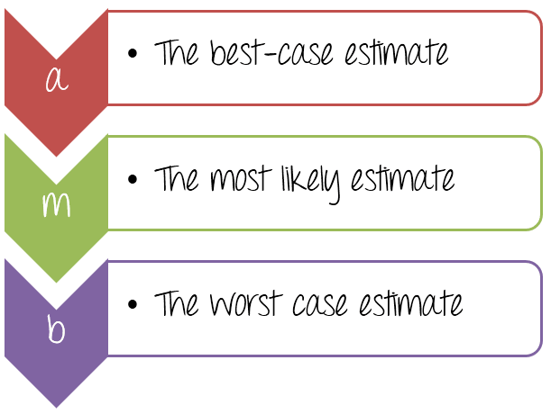
Three Point Estimation

Slide 35
Three Point Estimation
For the task “Create the test specification”, can you estimate the test effort?
You can estimate as following
  The best case to complete this task is 120 man-hours (around 15 days). In this case, you have a talented team, they can finish the task in smallest time.
  The most likely case to complete this task is 170 man-hours (around 21 days). This is a normal case, you have enough resource and ability to complete the task
  The worst case to complete this task is 200 man-hours (around 25 days). You need to perform much more work because your team members are not experienced.

Slide 36

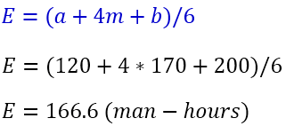
Three Point Estimation
Now, assign the value to each parameter as below
The effort to complete the task can be calculated using double-triangular distribution formula as follows-
In the above formula, parameter E is known as Weighted Average. It is the estimation of the task “Create the test specification”.

Slide 37

Three Point Estimation

Slide 38
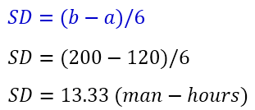
Three Point Estimation
In the above estimation, you just determine a possible and not a certain value, we must know about the probability that the estimation is correct. You can use the other formula:
SD mean Standard Deviation, this value could give you the information about the probability that the estimation is correct.
Now you can conclude the estimation for the task “Create the test specification”
To complete the task “Create the test specification” of Banking website, you need 166.6 ± 13.33 Man-hour (153.33 to 179.99 man-hour)

Slide 39
Steps to arrive at an Estimate

Slide 40
Steps to arrive at an Estimate
Step 4) Validate the estimation
Once you create an aggregate estimate for all the tasks mentioned in the WBS, you need to forward it to the management board, who will review and approve it.
The member of management board could comprise of the CEO, Project Manager & other stakeholders.
The management board will review and discuss your estimation plan with you. You may explain them your estimation logically and reasonably so that they can approve your estimation plan.

Slide 41
Software Test Estimation Template
https://drive.google.com/open?id=1Oh3zLvTrT5VOM_NNusSV7PmFPDr4-zw3

Slide 42
Test Management Phases

Slide 43
Planning- Test Plan
Summarize the purpose and content of a test plan
Differentiate between various test strategies
Give examples of potential entry and exit criteria
Apply knowledge of prioritization, and technical and logical dependencies, to schedule test execution for a given set of test cases
Identify factors that influence the effort related to testing
Explain the difference between two estimation techniques: the metrics-based technique and the expert-based technique

Slide 44
Planning – Test Organization
Now you have a Plan, but how will you stick to the plan and execute it? To answer that question, you have Test Organization phase.
Explain the benefits and drawbacks of independent testing
Identify the tasks of a test manager and tester

Slide 45
Test Management Phases

Slide 46
Execution – Test Monitoring and Control
Recall metrics used for testing
Summarize the purposes, contents, and audiences for test reports

Slide 47
Estimation – Issue Management
All projects may have potential risk. When the risk happens, it becomes an issue.
In the life cycle of any project, there will be always an unexpected problems and questions that crop up. For an example:
  The company cuts down your project budget
  Your project team lacks the skills to complete project
  The project schedule is too tight for your team to finish the project at the deadline.

Slide 48
Estimation – Issue Management
Risk to be avoided while testing:
  Missing the deadline
  Exceed the project budget
  Lose the customer trust
When these issues arise, you have to be ready to deal with them – or they can potentially affect the project's outcome.

Slide 49

Execution - Test Report & Evaluation

Slide 50
Execution - Test Report & Evaluation
The purpose of the Test Evaluation Reports is:
“Test Evaluation Report” describes the results of the Testing in terms of Test Coverage and exit criteria. The data used in Test Evaluation are based on the test results data and test result summary.

